Slide 1

Prediction of the traffic accidents and their severity
from UK, and data analyses

Slide 2
Introduction
The project aims to analyze a UK traffic accidents dataset spanning 2000 to 2016 using PySpark. With over 1.6 million records, PySpark is essential for efficient analysis. The dataset undergoes preprocessing for quality analysis, intending to generate graphs illustrating correlations, such as severity vs. time of day or speed limit vs. weather. The goal is to identify trends, predict accident severity based on conditions, and propose adjustments like adapting speed limits for specific situations (e.g., adverse weather, road quality) to enhance road safety.

Slide 3

Dataset Description
The dataset, obtained from UK government statistics on traffic accidents, spans 2005-2007 and 2009-2014, including accident details and average annual daily flow (AADT) for UK roads. Comprising four CSV files totaling 465 MB, the AADT file presents values for various vehicle classes. The accident files encompass 33 columns, featuring spatial and temporal details, speed limits, junction data, and pedestrian involvement. The dataset enables a comprehensive analysis of factors influencing traffic accident severity, allowing separate examination of spatial, temporal, and other components to identify trends and influential factors.

Slide 4
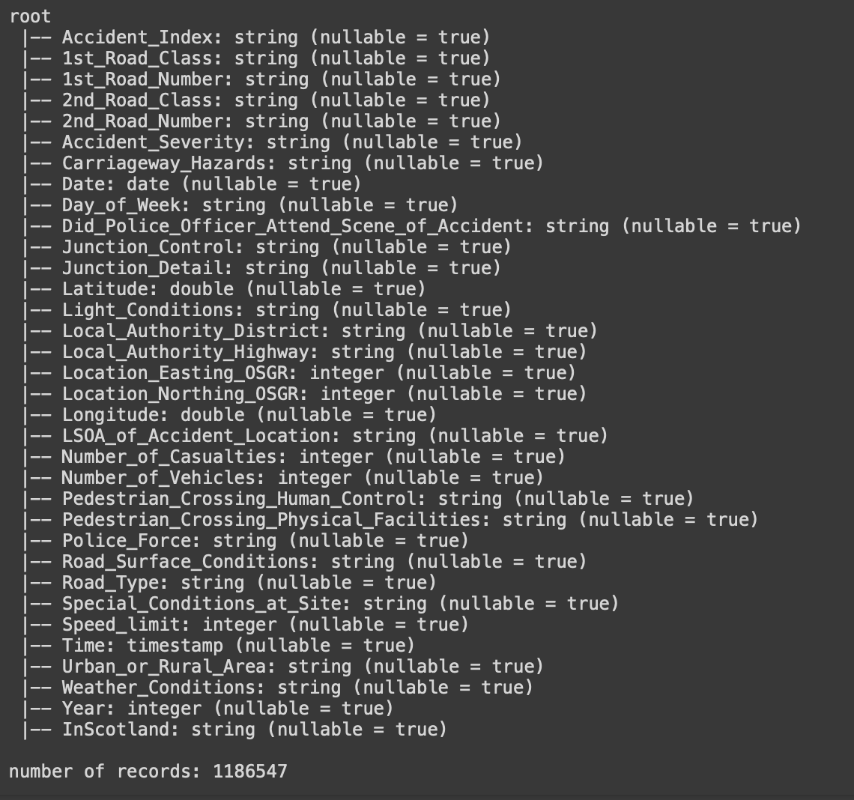

Slide 5
Methodology
We utilized SparkSession from PySpark to analyze the dataset, leveraging the efficiency of distributed processing.
Employing PySpark's Spark Streaming, we performed real-time analysis of the dataset during processing, ensuring dynamic insights.
Conducting inferential statistical analysis, we explored correlations among variables, emphasizing trends in accident severity. Subsequently, predictive analysis involved a multilayer perceptron network to forecast severity levels, facilitating easy experimentation and modification within a Jupyter notebook environment.

Slide 6
Preprocessing
Data Cleaning:
Preprocessed raw data by cleaning and refining features related to "Accident Severity."
Key features considered: location (Longitude, Latitude, LSOA_of_Accident_Location), timing (Time, Date, Day_of_Week), and environmental conditions (Light Conditions, Weather Conditions, Road Surface Conditions, Speed Limit, Road Type).
Data Formatting:
Implemented the second preprocessing step by formatting the raw data.
Created new variables: "Month" based on "Date" and "Hour" based on "Time."
Converted numerical variable "Day_of_Week" into a string.
Data Transformation:
Conducted a transformation of numerical values within the "Accident Severity" variable.
Converted numerical severity values into categorical labels: "Fatal," "Serious," and "Slight."

Slide 7

Data Analysis

Slide 8
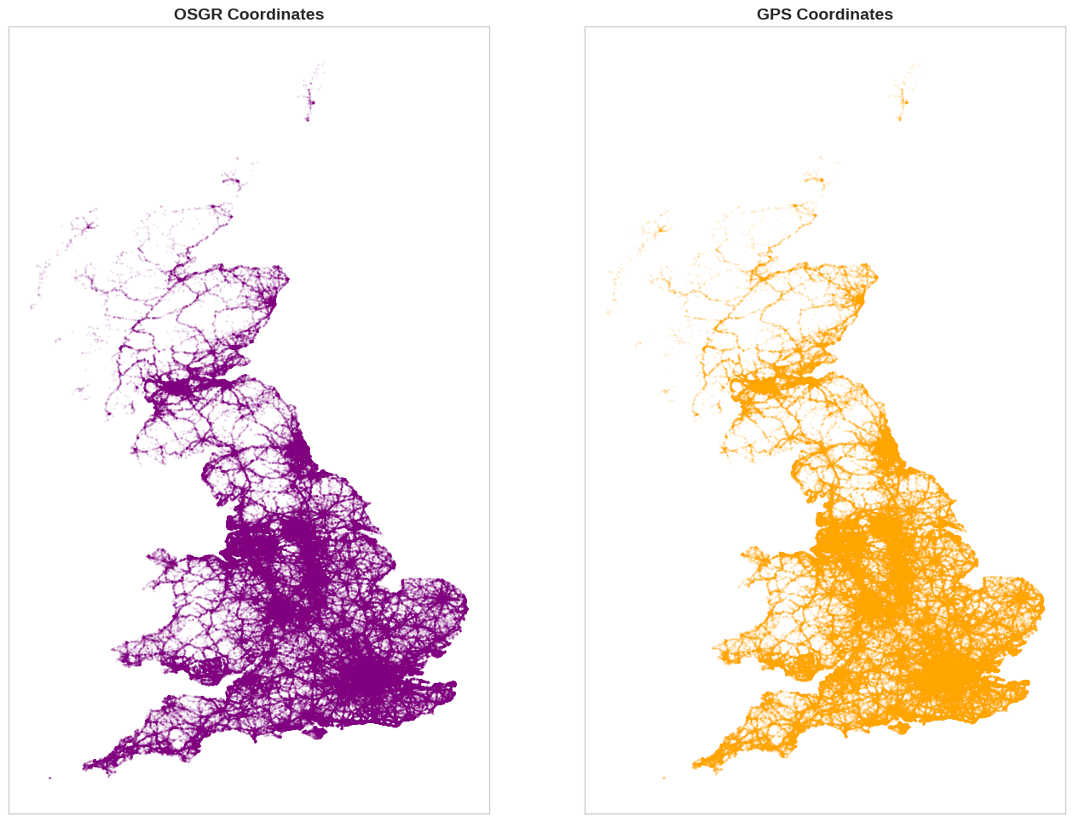
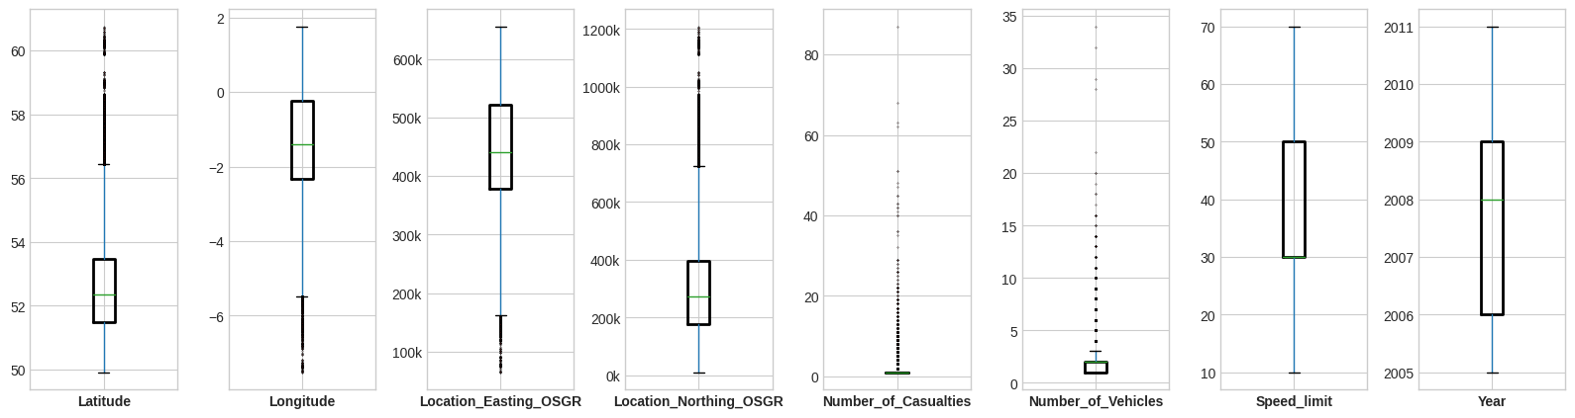
Outlier Detection
Longitude and Latitude were plotted to see if there are any outliers in the data. As can be seen, the data for northern Ireland is missing. The accidents appear most frequently in the big cities, such as London, Birmingham, Liverpool, Manchester and Sheffield

Slide 9
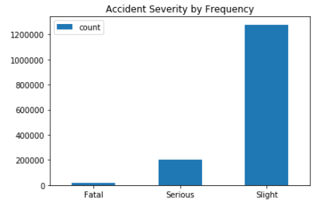
Action Severity by Frequency
The fatal accidents rarely occur in the data, so the slight accidents shape most of the data tendencies. Therefore, fatal and non-fatal accidents will be analyzed separately on the basis of environmental conditions.

Slide 10
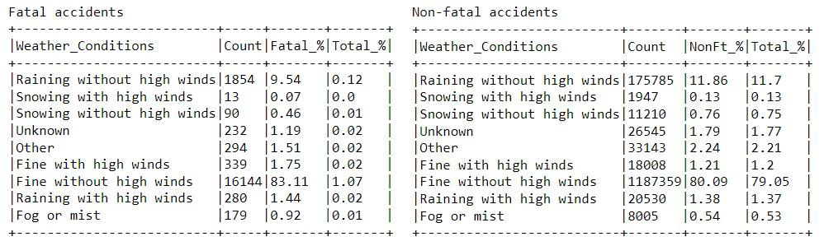
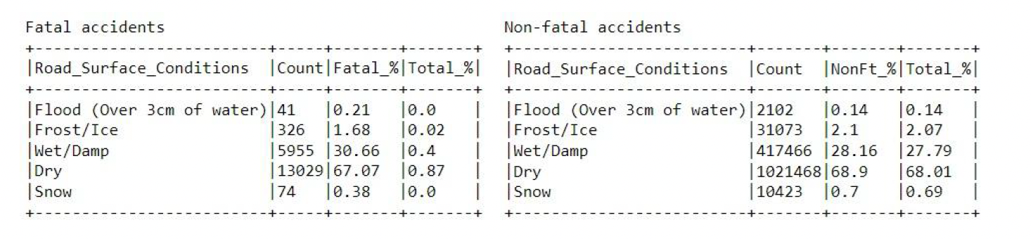
Most of the accidents (fatal and non-fatal) happen in fine weather without high wind, because this is the most common weather throughout the year. There is no clear weather factor that could affect the severity of the accident.
In light conditions, fatal accidents are more likely to occur when streetlights are not present
A lot of accidents happen when the road surface is wet or damp.
Notes:
Most of the accidents (fatal and non-fatal) happen in fine weather without high wind, because
this is the most common weather throughout the year. There is no clear weather factor that
could affect the severity of the accident.

Slide 11
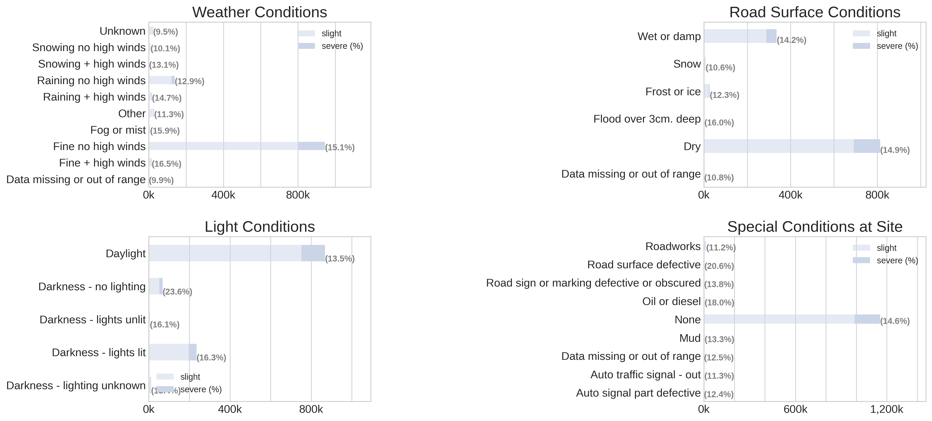
Notes:
Most accidents occur in normal weather, only Fog or High winds increase the proportion of severe accidents
Darkness significantly increase the probability of severe accidents
Bad Road surface conditions do not increase accident severity

Slide 12
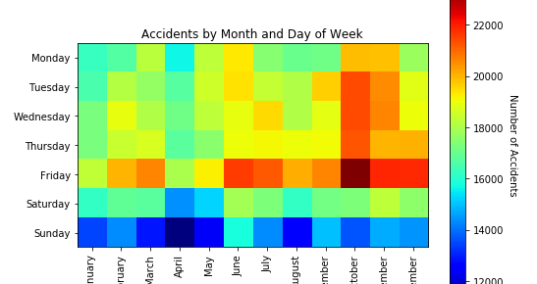
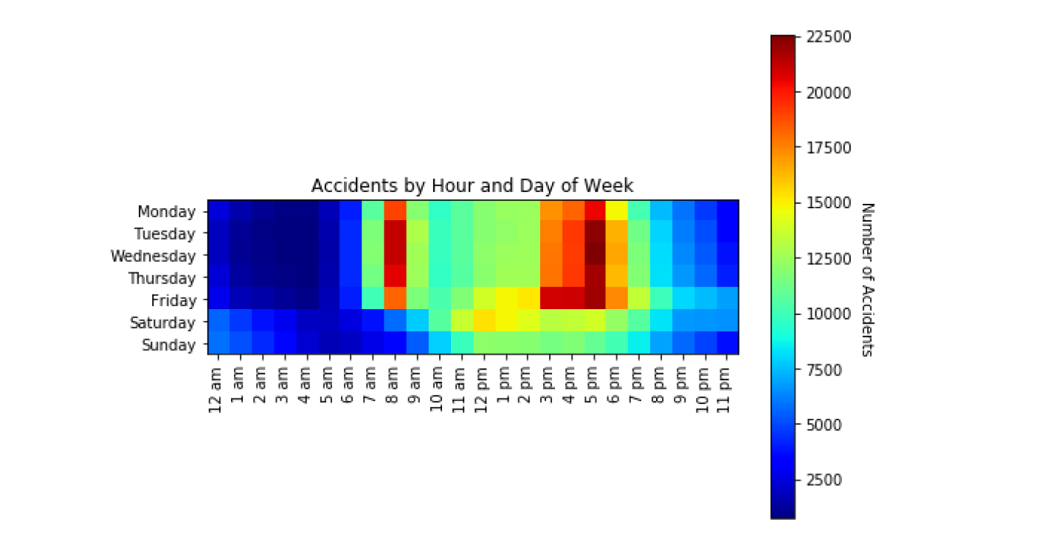
For months, October and November have the most accidents. This might be a combination of many factors. Firstly, lighting conditions get worse, because of reduced sunlight. Secondly, temperatures drop and rain increases causing the road to get wet and slippery. Summer also has a greater number of accidents, probably because of increased traffic from vacation trips.
From the time of day graph we can see that most accidents are concentrated on regular commute times in the morning with a longer window in the evening, maybe due to some people driving to leisure activities after work. We can see traffic decreasing on the weekends but with more accidents at night.

Slide 13
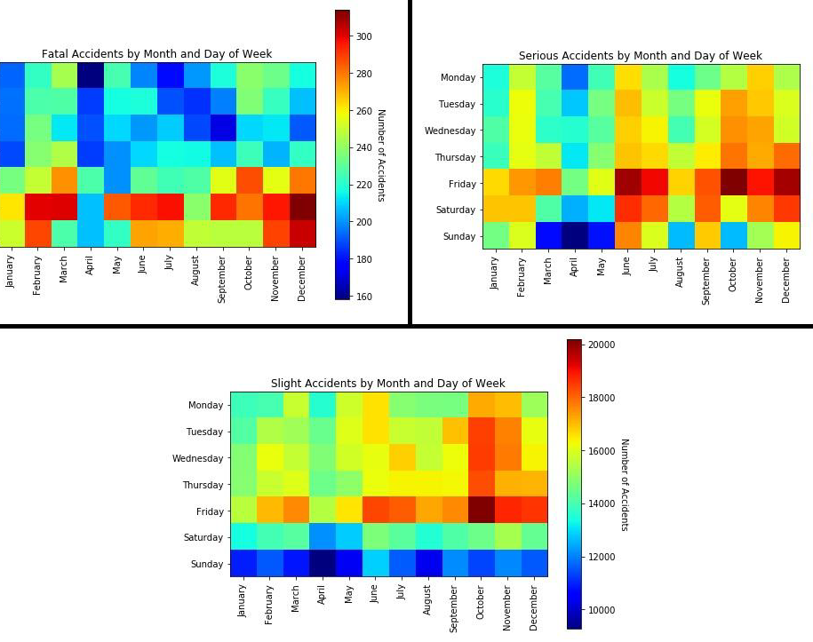
In the total accident graph the slight accidents probably dominate the data because of the disproportionate distribution. When we plot the three different severities independently, interesting patterns emerge. Fatal accidents seem to be concentrated on the weekends, Probably because of increased intoxication and general lackadaisical attitude at the wheel. When we move down on the severity scale we move more towards the day and the weekday workdays. People might be more aware of their surroundings and less under the influence, so accidents still happen due to greater traffic flow, but the severity of them are reduced.

Slide 14
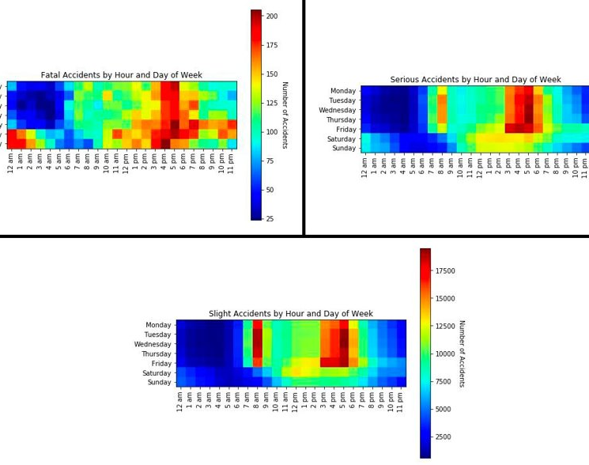
From the time of day graph we can see that most accidents are concentrated on regular commute times in the morning with a longer window in the evening, maybe due to some people driving to leisure activities after work. We can see traffic decreasing on the weekends but with more accidents at night

Slide 15

Prediction Analysis

Slide 16
Preprocessing Step
Heavy Resampling for Class Imbalance
Addressed extreme class imbalance through resampling techniques.
Experimented with downsampling the more frequent classes to the minority class's level and upsampling the smallest class to the middle class's level, alongside downsampling the majority class.
Caution with Imbalanced Datasets:
Highlighted the challenge of model accuracy in imbalanced datasets.
Noted that models might achieve high accuracy by naively predicting the majority class, emphasizing the importance of evaluating performance across all classes.

Slide 17
Feature Engineering
After completing the preprocessing steps, we proceeded to generate feature vectors using PySpark's StringIndexer and VectorAssembler. This involved encoding string columns into machine-interpretable numeric values and combining these values to create vectors.
Despite extensive experimentation with various feature vector selections, model configurations, and the aforementioned resampling schemes, the results consistently fell short of our expectations.
Recognizing the limitations of our approach with StringIndexer, we transitioned to building an original pipeline for string column embedding and column value normalization. Unlike StringIndexer, this approach allowed for the instantiation of values during the fitting process, addressing a crucial aspect. The embedding process comprises two steps: creating a mapping dictionary that links unique string values to integers based on their frequency and constructing an accumulator with multiple when clauses to be applied to the column, altering its values accordingly.
We added some additional features also : Week feature to incorporate seasonal effects , peak and off peak feature and latitude and longitude features.
Once this process is applied to all string columns, we normalize all rows to a specified range. We experimented with both the ranges 0 to 1 and -1 to 1. It's important to note that the label column 'Accident_Severity' is not normalized.

Slide 18
Machine Learning Algorithms
Gradient Boosting Trees
Deep Neural Network

Slide 19
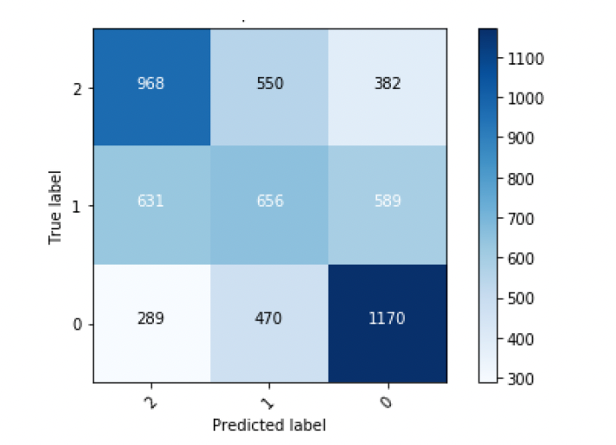
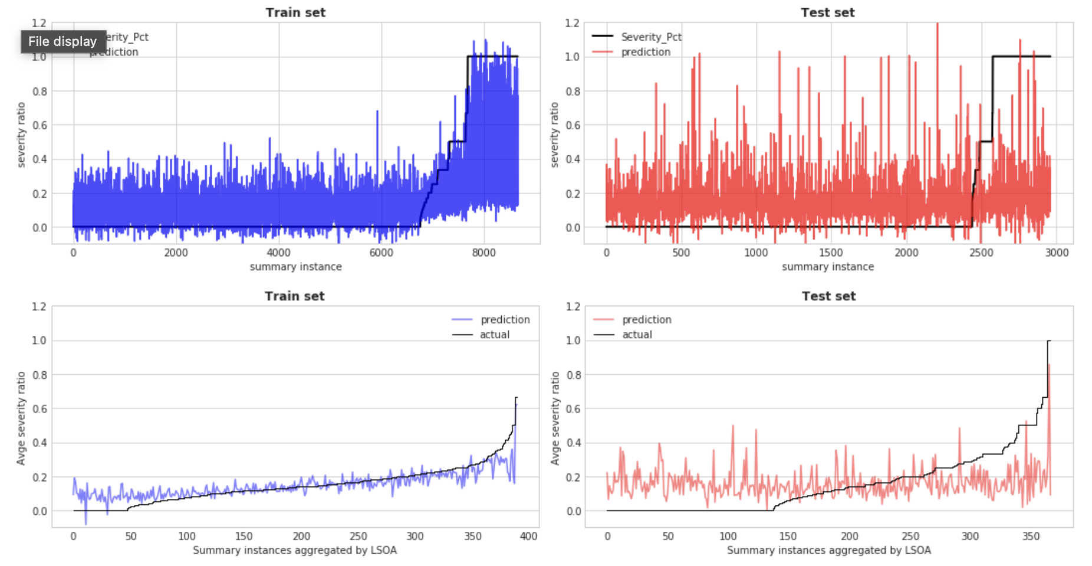
Gradient Boosting Trees
Root Mean Squared Error (RMSE) on train data = 0.22 R2 (explained variance ratio) on train data = 0.26 Root Mean Squared Error (RMSE) on test data = 0.28 R2 (explained variance ratio) on test data = -0.04

Slide 20
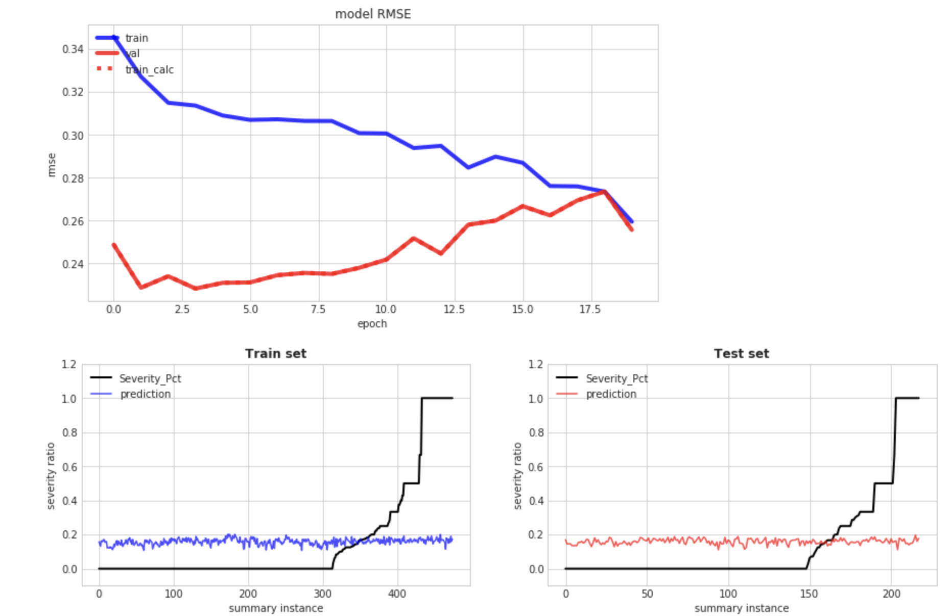
Deep Neural Network
Root Mean Squared Error (RMSE) on train data = 0.29 Root Mean Squared Error (RMSE) on test data = 0.27
Accuracy 75%
Both the small and the large deep network have better RMSE metrics than the GBT regressor but cannot capture the real dynamics of the dataset. They just find the best average

Slide 21
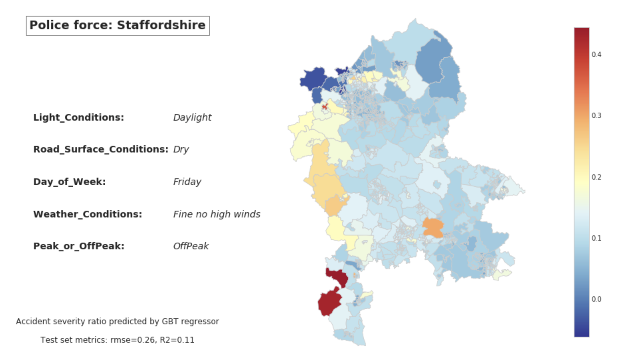
Evaluation
Predict accident severity at each output area (LSOA) given datetime and driving conditions

Slide 22
Conclusion
Accidents are most frequent during autumn, especially on weekdays and Fridays.
Morning and evening rush hours pose the highest risk.
Large cities, notably London, experience the highest accident rates.
Severe accidents are associated with factors like no street-lights, wet roads, and high-speed limits.
Fatal accidents are more common on dual carriageways and during late-night hours, particularly on weekends.
Weather conditions seem to have minimal impact on accident severity.
Prediction models achieved approximately 74% accuracy.
Models performed better at extreme severity levels but struggled with middle values.
Consideration of data imbalance is crucial for accurate prediction models based on this dataset.

